Slide 1
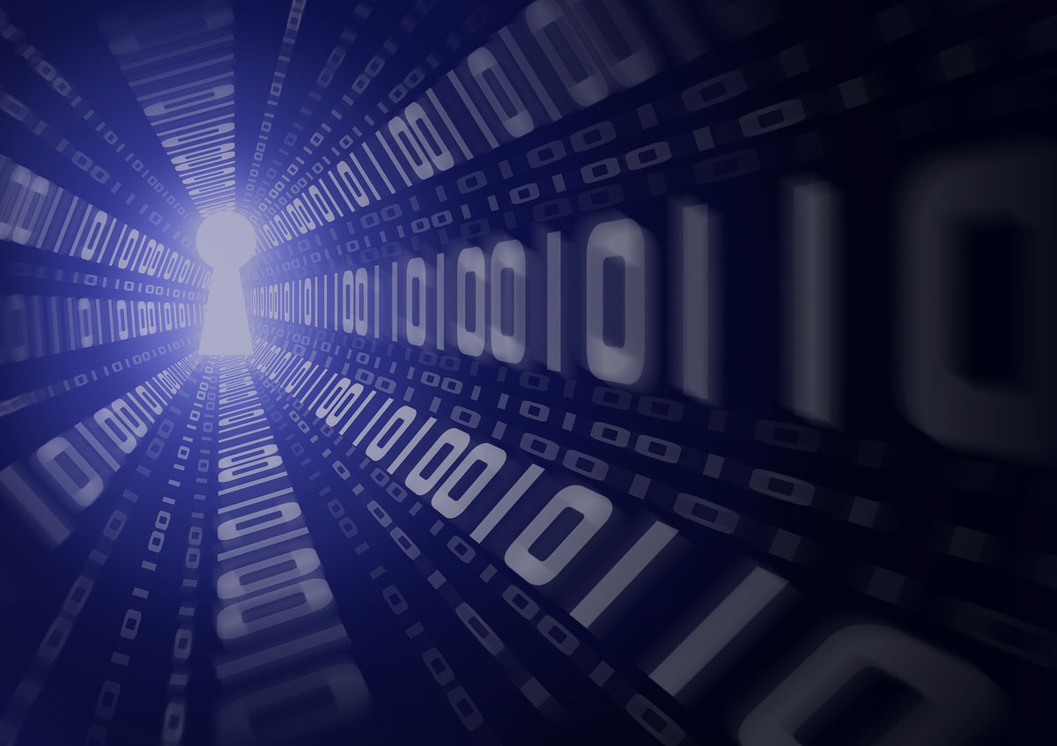
GALGOTIAS UNIVERSITY
SCHOOL OF COMPUTING SCIENCE AND ENGINEERING
Project ID: BT2177
Title: EXPENSE TRACKER APP
PROJECT MEMBERS
KARANJEET SINGH 21SCSE101644
ABHINAV KUMAR CHOUDHARY 21SCSE1011615
SHIVANI KUMARI 21SCSE1011614
EBAD ZAFAR 21SCSE1011484
Under the guidance
Mr. Janarthanan S
Assistant Professor

Slide 2
Content :
Introduction
Problem Statement
Project Scope
Goals
Product Features
Tools & Technology
Project Architecture
JWT Tokens
References

Slide 3
INTRODUCTION :
The main purpose of this project is to provide a platform for a user to keep track of their expenses
Tracking daily expenses really helps us in saving a lots of money
Purchase in controlled manner everywhere (online shopping, supermarket, mall , etc)
Able to get regular remainder if we do so many expenses as limit set

Slide 4
Problem Statement :
At the end of month we have to suffer from money crisis
Lack of proper planning of our income
Persons have to carry one diary and pen for entry of money spent everywhere
All calculation needs to be calculated by the user
Overload on person for daily entry which can increase extra work

Slide 5
Project Scope :
The following are some of the specific problems addressed by the application:
Lack of Accessibility: The expense tracker application solves this problem by providing a platform that is accessible from any device with an internet connection.
Inefficient Spending Habits: People often spend money without realizing how much they are spending on specific items or categories.
Inadequate Budgeting Tools: Many individuals struggle with budgeting and finding the right tools to help them keep track of their expenses.
Unsecured Data: Storing financial information on paper or spreadsheets can be risky, as it can be lost, damaged, or stolen.

Slide 6
Goals :
The main goal of the expense tracker application is to empower users to take control of their finances and make informed decisions about their spending.
To provide users with a simple and intuitive platform for managing their daily expenses.
To allow users to categorize their spending and view their spending history in a user-friendly interface.
To provide users with a comprehensive and effective solution for managing their daily expenses that is simple, secure, and accessible.
To generate reports for users' spending habits, so they can track their expenses over a specific period of time.

Slide 7
Product Features :
User-friendly interface
Add, edit, and delete expenses
Categorize expenses
View spending history
Generate reports
Secure data storage

Slide 8
Tools and Technology used :
The operating environment for the expense tracker application built in the MERN stack typically consists of the following components:
Server-side Environment:
Node.js - It is JavaScript runtime environment
Express - It is framework for Node.js
MongoDB – It is NoSQL database for storing data of users
Client-side Environment:
React – It is JavaScript library for building user interface
Development Environment:
Code Editor - It is used to write code (Vs Code , Atom , etc)
Web Server – It is used to host the application

Slide 9
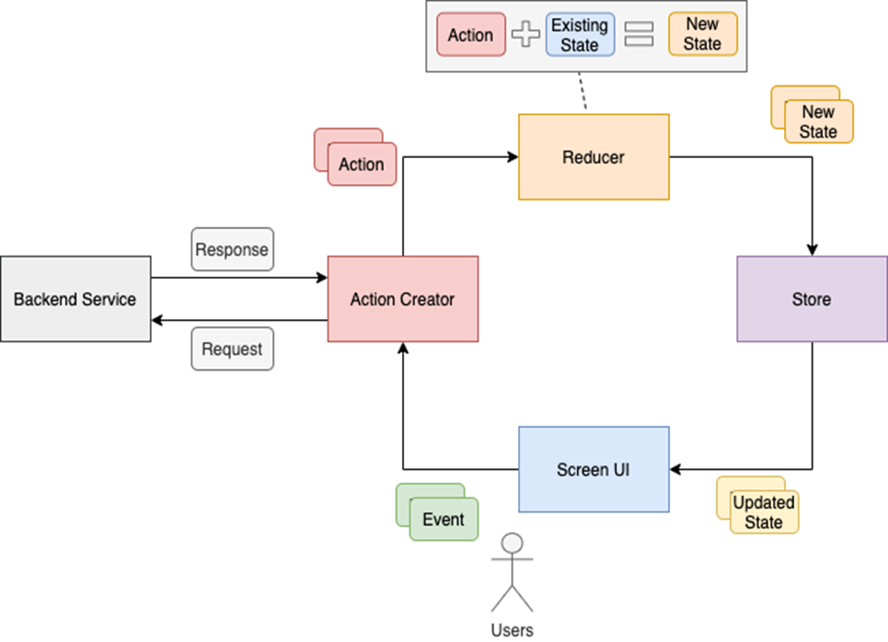
Project Architecture

Slide 10
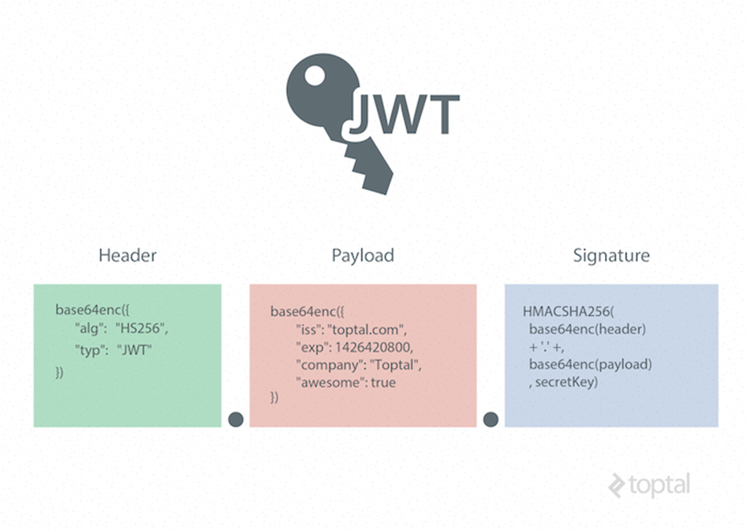
JWT Tokens

Slide 11
References :
www.geekforgeeks.com
www.w3schools.com
https://reactjs.com
https://expressjs.com
https://mongodb.com
https://github.com
https://nodejs.com
www.javapoint.com
https://php.net

Slide 12
THANK YOU

